Slide 1
Quantitative Methods Lecture-3

Slide 2
Numerical Descriptive Measures
(Ch 2 & 3 Business Statistics, Levine et al.)

Slide 3
So far and the next
Previous Sessions
Defining and collecting data
Survey and sampling methods
Organizing and visualizing variables
Session 3:
Numerical descriptive measures

Slide 4
Nominal / Categorical
Meaning of numerical descriptive measures?
Describe the data in a numerical way
Contingency tables
Relationship between two variables, cross tabulations
% of female and male customers by product types
Descriptive measures for nominal/categorical & ordinal variables?
Frequency, cumulative frequency, proportions (%)
Next: Numerical descriptive measures for
Numerical variables (measured on interval or ratio scales)

Slide 5
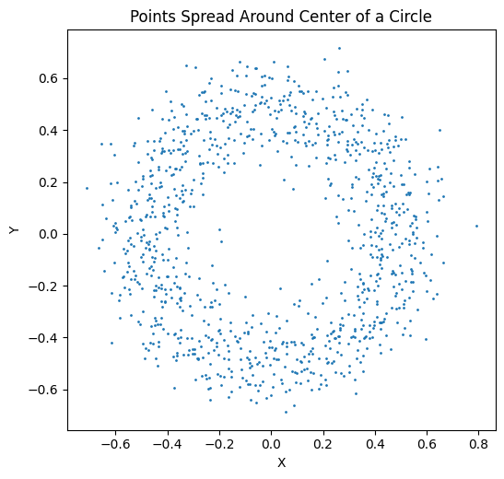
Numerical measures
Central tendency (?)
Mean, mode and median
Dispersion or spread
Around the central point
Source: Self generated image

Slide 6
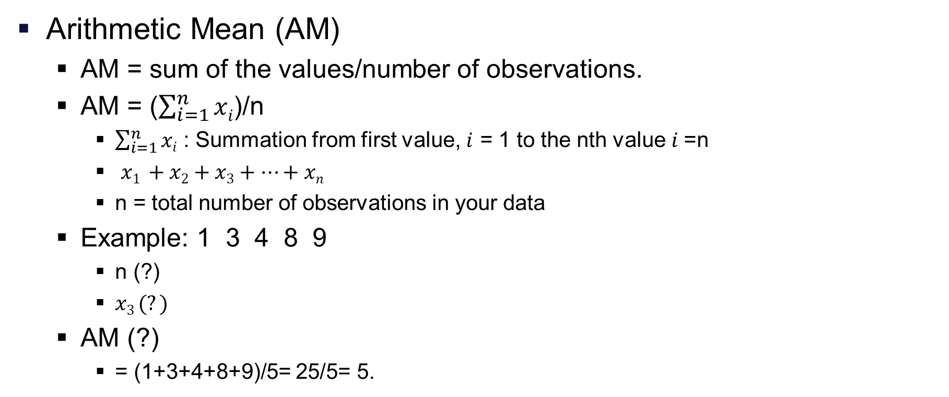
Central tendency measures for raw data
Arithmetic Mean (AM)
AM = sum of the values/number of observations.
AM = ($\sum_{i=1}^{n}{xi}$)/n
$\sum_{i=1}^{n}{xi}$ : Summation from first value, $i$ = 1 to the nth value $i$=n
$x1 +x2+x3+…+xn$
n = total number of observations in your data
Example: 1 3 4 8 9
n (?)
$x3 (?)$
AM (?)
= (1+3+4+8+9)/5= 25/5= 5.

Slide 7
Central tendency measures for raw data
Median- value of middle observation
After sorting the data in ascending order.
Median = (n+1)/2 number
Examples:
1 3 4 8 9, Median value = (?)
1 3 4 8 9
1 3 4 8 9 1, Median value = (?)
1 3 4 * 8 9 1
1 1 3 * 4 8 9
Median value= 3.5 = (3+4)/2.

Slide 8
Central tendency measures for raw data
Mode
Value of most frequently occurring observation in the data
Examples:
2 2 3 4 5, Mode value= (?)
2 2 3 4 5 (Mode value =2)
22 30 40 40 50 50 66 (Mode value= ?)
22 30 40 40 50 50 66 (Mode values= 40 and 50)
Bi modal
1, 2, 3, 4, 5 (Mode value= ?)
May not have any Mode

Slide 9


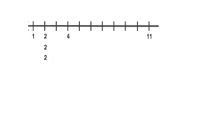
When to use which measure
Data Points: 2, 4, 6, 8, 10 (Which is the best measure?)
Mean: 6, Median: 6, Mode: No mode
Mean as the Best Measure (Balanced data)
Data Points: 1, 2, 3, 4, 20
Mean: 6, Median: 3, Mode: No mode
Data with extreme values
Data Points: 1, 2, 2, 2, 4, 6, 11
Mean: 4, Median: 2, Mode: 2
Mode is generally the only measure with nominal data

Slide 10
When to use which measure
Mean
Data should be approximately equally spread about the center
Median
When there are extreme values
Skewed distribution of data
Salary offered to collage graduates
Mode
Rarely used for numerical data
Who wins the election? (Modal voted candidate)
For categorical data – it is the only measure available
Highest frequency

Slide 11
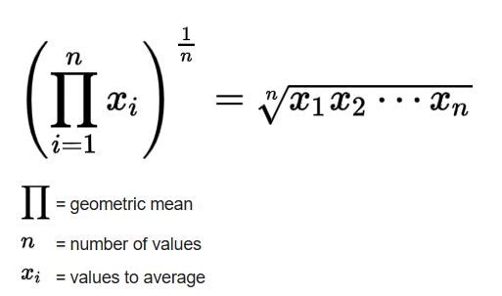
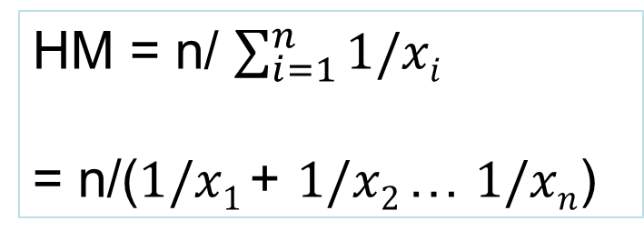
Others means
Geometric mean
Only works with positive numbers
High volatility, different units
Harmonic mean
When greater weight needs to be given to smaller values (Outlier issues)
Averages ratios and rates
AM>GM>HM
HM = n/ $\sum_{i=1}^{n}{1/xi}$
= n/($1/x1$+ $1/x2$… $1/xn$)

Slide 12
Mean of Grouped Data
Grouped Mean = ∑f.x / ∑f
f = Frequency (Number of items in the group), x = Mid Value
0 0 0 0 1 10 21
32/7 ~ 4.6
0-10 6 5 30
10-20 0 15 0
20-30 1 25 25
55/7 ~7.7
x | Frequency (f) | Mid Value (x) | f.x
[0-10] | 20 | 5 | 100
(10-20] | 10 | 15 | 150
(20-30] | 15 | 25 | 375
(30-40) | 25 | 35 | 875
(40-50] | 10 | 45 | 450
 | ∑f = 80 |  | ∑f.x= 1950
Mean = (?)
Mean = 24.375
Note: Mean of Raw data is generally not equal to mean of grouped data (why?)

Slide 13
Median of Grouped Data
Class Interval | Frequency (f) | Cum Freq
[0-10] | 10 | 10
(10-20] | 10 | 20
(20-30] | 15 | 35
(30-40) | 25 | 60
(40-50] | 10 | 70
Median, Me = l + {h x (N/2 – cf )/f}
Where,
l = lower limit of median class.
h = width of median class
f = frequency of median class,
c_{f} = cumulative frequency of the class preceding the median class.
N = ∑f_{i}
(Median class?)
Note: Not in syllabus
Median point: (70+1)/2 = 35.5
Median class: 30-40

Slide 14
Mode of Grouped Data
Class Interval | Frequency (f) | Cum Freq
[0-10] | 10 | 10
(10-20] | 10 | 20
(20-30] | 15 | 35
(30-40) | 25 | 60
(40-50] | 10 | 70
Mo = x_{k} + h{(f_{k} – f_{k-1})/(2f_{k} – f_{k-1} – f_{k+1})}
Where,
x_{k} = lower limit of the modal class interval
f_{k} = frequency of the modal class.
f_{k-1}= frequency of the class preceding the modal class.
f_{k+1} = frequency of the class succeeding the modal class.
h = width of the class interval.
(Modal class?)
Note:
1. What if modal class is first or the last class?
2. Not in syllabus

Slide 15
Few properties of Mean, Median, Mode
Mean (AM) | Median | Mode
AM is unique. 1 2 3 4. AM=2.5. | Median is unique 1 2 8 18. | Mode may not exist. 11 12 13 14. Multiple modes may exist 11 12 13 14 15 15 16 16.
Change in the value of any observation always affects AM. 1 2 3 4. AM=2.5. 1 2 3 8. AM=3.5. | Change in the values may not affect Median. 1 2 3 4 5 6 7 8 9 1 2 3 4 5 6 7 8 10000000 | Change in the values may not affect Mode. Blue Green Red Red Red Yellow Mode remains Red even if Yellow is replaced by Blue.
AM cannot be computed if all values are not available. 1 2 3 X. AM=? | Median may be computed even if values of all observations are not available. 1 2 3 4 5 6 7 9 X The Median will remain the same even if the largest value X is unknown. | May be computed even if values of all observations are not available. 1 2 3 3 3 3 4 X The Mode will remain the same even if value X is unknown.

Slide 16
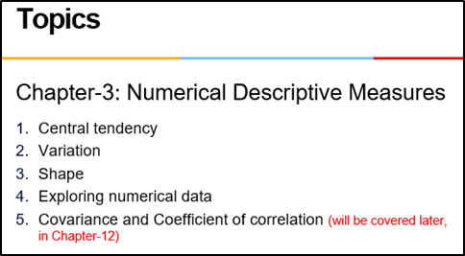
Variation

Slide 17

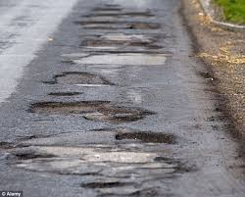
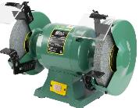
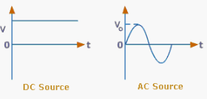
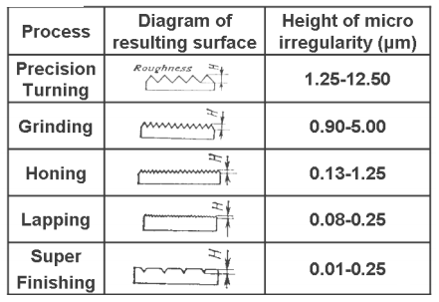
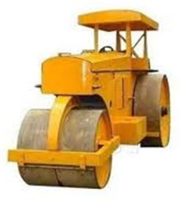
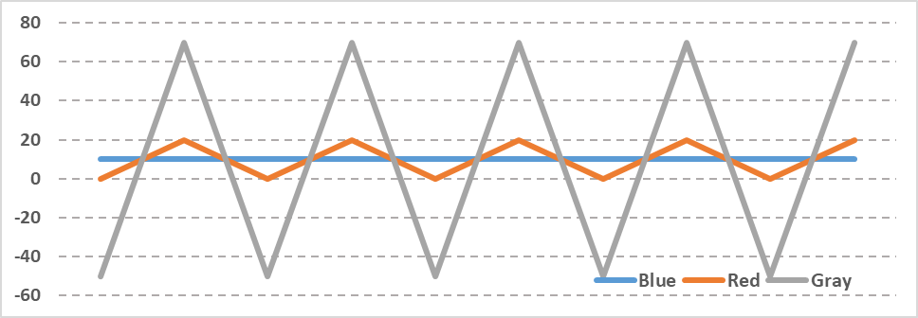
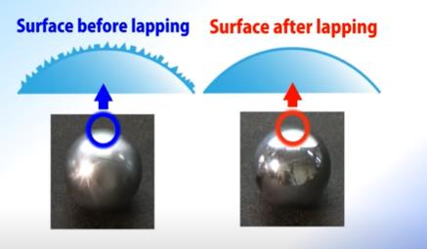
Variation in daily life
Manpower deployment

Slide 18
Measuring variation
Range = Maximum-Minimum
Variance, population = σ² = 1/N * ∑ (x_{i}-Mean)²
Standard deviation, population = σ
Coefficient of Variation, population = σ/Mean
Variance, sample = s² = 1/(N-1) * ∑ (x_{i}-Mean)²
Standard deviation, sample = s
Coefficient of Variation, sample = s/Mean
Mean absolute deviation = 1/N * ∑ |x_{i}-Mean|
Z score (how many std devns is xi
away from the mean) = [x_{i}-Mean]/ σ
Quartiles (Q₁, Q₂, Q₃) Smallest 25%, 50%, 75% observations.
Inter-quartile range = Q₃ – Q₁
5-number summary (Min., Q₁, Q₂, Q_{3,} Max.) Minimum, 3 Quartiles, Maximum
Boxplot (Called Box and Whisker chart in MS Excel) Plot of 5-number summary

Slide 19
Why measure variation?
In order to make decisions such as which stock to invest?
Would you like to invest in stock which shows great variation in price or smaller variation in price
Both on the negative side and the positive side
In order to evaluate which process is better?
Generally, a process with lesser variation is better (credit risk assessment of a customer)
Product quality improvements
Measuring the current state of variation in the process parameters
Reducing variation from acceptable benchmarks

Slide 20
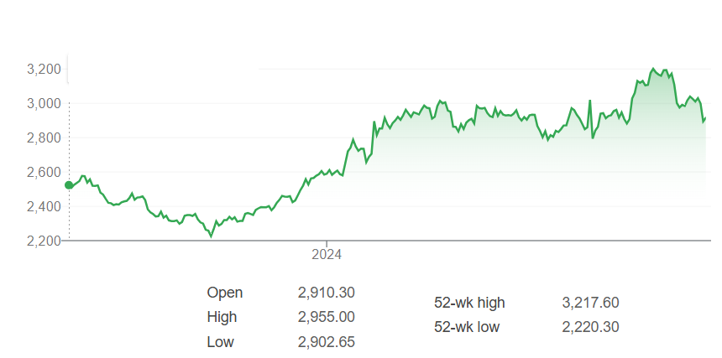
Measure of spread: Range
Range = Maximum Value – Minimum Value
Max
Sample Data
2
5
7
10
15
20
Min
Range?
18

Slide 21
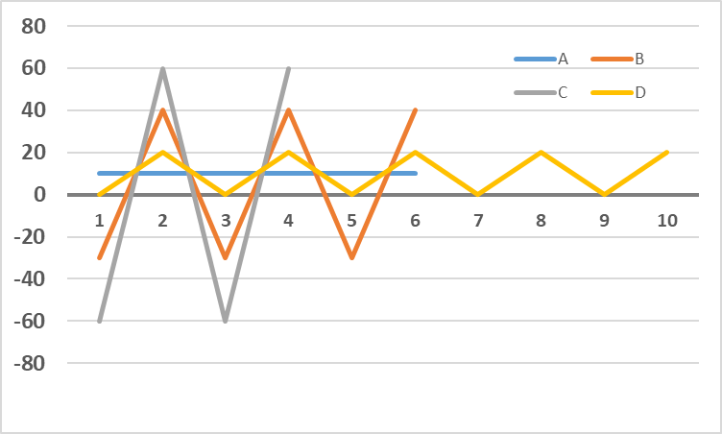
Highest and Lowest variations (By Range)?
Range = Maximum Value – Minimum Value
Price
Days
Variation: C > B > D > A

Slide 22
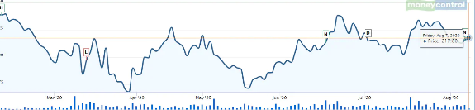
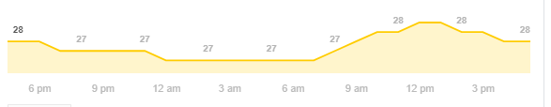
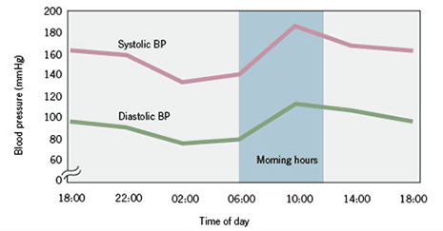
Range- Uses and shortcomings
Stock price during a day
Uses
Stock price- minimum and maximum in a day.
Ambient temperature- minimum and maximum in a day.
Blood pressure- high and low within few minutes.
Range is computed only from two observations. Hence, easy to compute.
Shortcomings
Range is computed only from two observations,
Does not capture distribution of variation
Not suitable for data with extreme values 31 41 5 9 26 53 58979 3 23 ...
Range = (58979-3) = 58976.
Temperature during a day

Slide 23
Measure of spread: Variance and Standard Deviation
Variance (population) (σ²⁾ = 1/N * ∑ (x_{i}-Mean)²
Sample Data | X-mean | (X-mean)^2
1 | -10.0 | 100.0
5 | -6.0 | 36.0
15 | 4.0 | 16.0
10 | -1.0 | 1.0
15 | 4.0 | 16.0
20 | 9.0 | 81.0
N = 6, Mean = 11 |  | 250.0
σ² = (∑ (x_{i}-Mean)²)/N = ?
σ² = 41.67
Variance _{sample} (s²) = 1/(N-1) * ∑ (x_{i}-Mean)²
Standard deviation, population = σ (square root of variance) Also called RMSE (Root Mean Square Error)
Standard deviation, sample = s
Coefficient of Variation, population = σ/Mean
Coefficient of Variation, _{sample} = s/Mean

Slide 24
Variation and Standard Deviations
Standard deviation = RMSE

Slide 25
Coefficient of Variation (CoV)

Slide 26
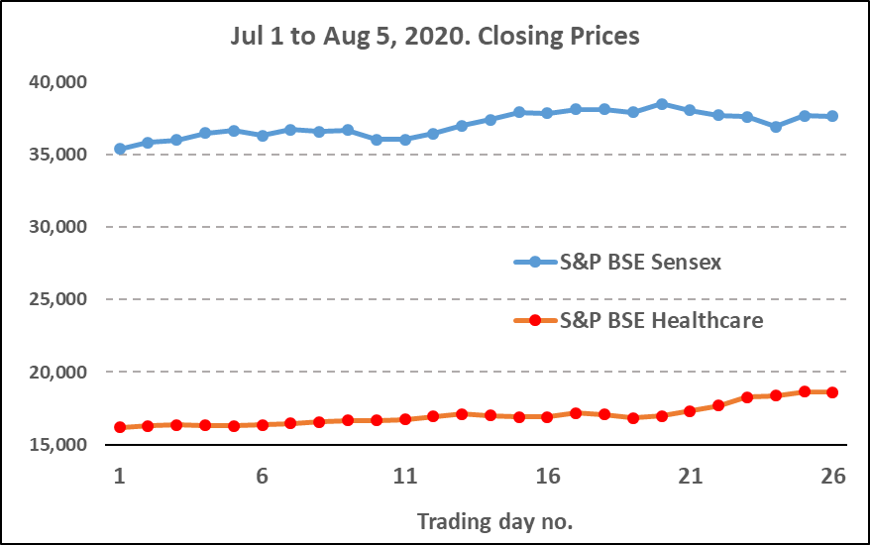
Higher variation, Red or Blue?
According to Range and Standard deviation, Sensex had higher variation than Healthcare index.

Slide 27
Coefficient of Variation, CoV
Coefficient of Variation (CoV) = Standard deviation/Mean
According to CoV, Healthcare index has higher variation.
When means of two data differ a lot,
Units are different
CoV may capture the variation better than Standard deviation.
What is the unit of standard deviation?
What is the unit of CoV?

Slide 28
Z score

Slide 29
Z score
How far is the observation from mean, in terms of standard deviations.
Z score of 1, 2, 3, 4, 5? Mean = 3.
Z = (ObservedValue - Mean)/Standard deviation
= Error/Standard deviation
Z-Score
Not a summary measure
It is computed for each data point.

Slide 30
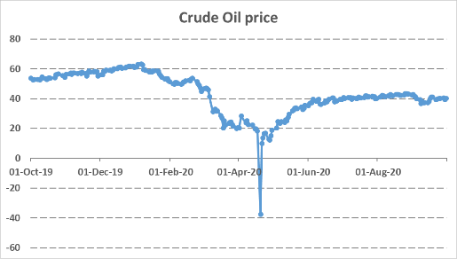
Z scores- Example and Uses
Z scores of 1, 2, 3, 4, 5? Mean = 15/5=3, Standard deviation= 1.41
What is the Z score of 1?
(1-3)/1.41 = -1.41
What is Z score of 3?
(3-3)/1.41 = 0
Uses
To identify Outliers (extreme values).
Z value < -3 or > 3 are often considered Outliers.
To read Normal distribution table (Chapter-6)
To estimate Confidence Intervals (Chapter-8)
To test Hypothesis (Chapter 9,10, and 11).
-3 -2 -1 0 1 2 3
Z score

Slide 31

3. Shape of the data- Skewness

Slide 32
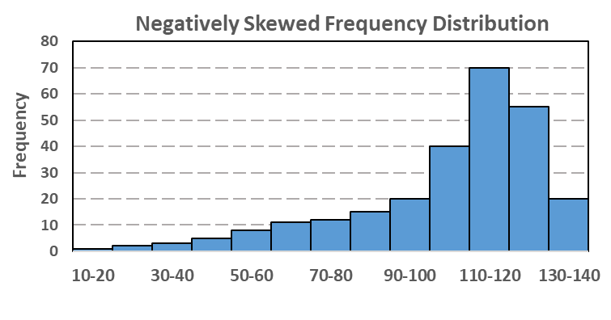
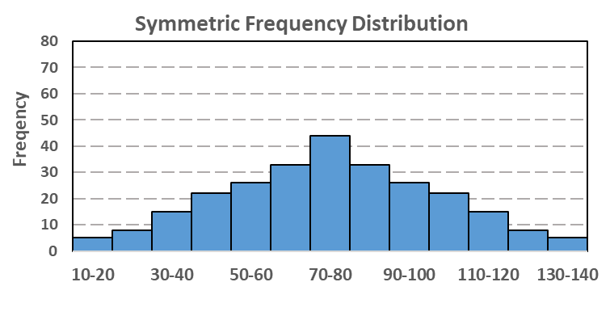
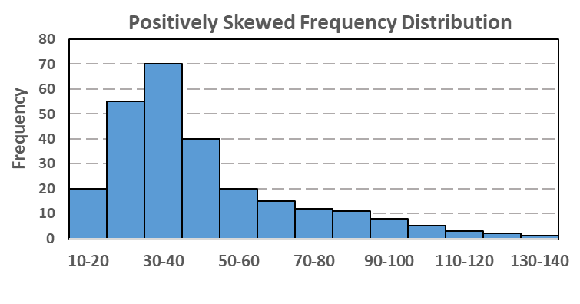
Symmetry (or lack) of frequency distributions
Mean < Median < Mode
Mean = Median = Mode
Mean > Median > Mode
Tail on the left, -ive Skewed
Ex: Japan’s population age
Symmetric
Ex: Distribution of height
Tail on the right, +ive Skewed
Ex: Wealth, income, family size
Frequency distribution in the middle is symmetric, and other two are not symmetric.
Skewness measures deviation from symmetry.
Computation of Skewness is not in the syllabus.
-ive skewed 0 +ive skewed
Symmetric
Skewness of
Left distribution= -1.28
Middle distribution= 0
Right distribution= +1.28
MS Excel function, Skewness = Skew(Range).

Slide 33
Typical frequency distributions-
MMM relationships
Lower spread
Higher spread

Slide 34
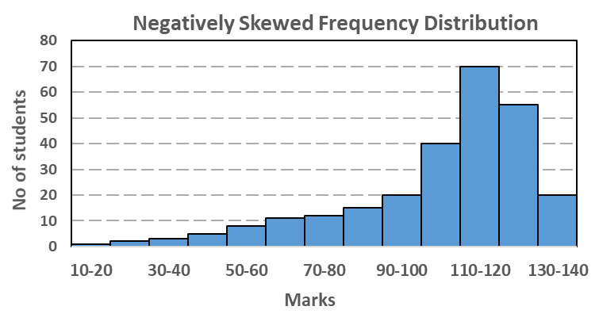

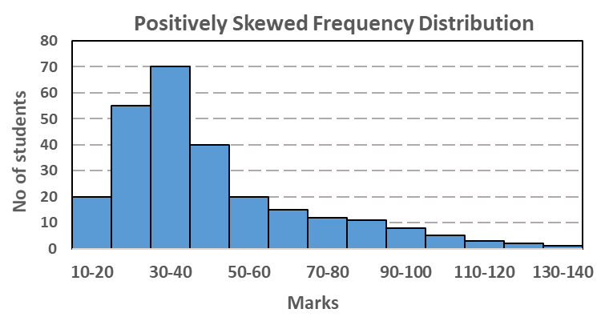
HW…. A tale of 3 exams
What do results of these exams indicate?

Slide 35
Shape of the data- Kurtosis

Slide 36
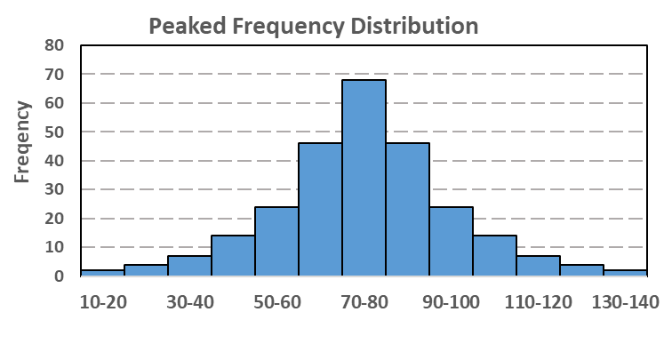
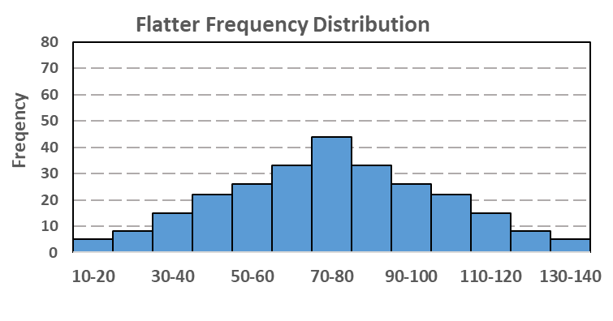
Flatness (or Peakedness) of a frequency distribution
Frequency distribution on the right is flatter.
Kurtosis measures Flatness (or Peakedness) of a frequency distribution.
Calculation of Kurtosis is not in the course.
0 Kurtosis
Kurtosis of
Distribution on the left- 1.26
Distribution on the right- 0.067
MS Excel formula, =Kurt(Range).

Slide 37
Quartiles

Slide 38
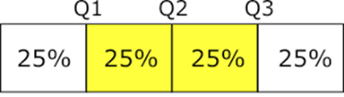
Quartiles (from Quarters)
Divide the sorted data into 4 quarters- 25% observations in each quarter.
Q1, First Quartile- Lowest 25% observations
(N+1)/4th
Q2, Second Quartile- Lowest 50% observations
(N+1)/2th
Q3, Third Quartile- Lowest 75% observations.
3/4(N+1)th
Inter-Quartile Range (IQR) = Q3-Q1.
Notice that Q2 = Median.
Quartiles are used to study variation in the data, and to spot whether distribution of data is symmetric.
Used in 5-number summary and Boxplots.
IQR = 800 - 90 = 710.
Outliers: More than Q3+1.5 IQR or less than Q1-1.5 IQR

Slide 39
5-number summary

Slide 40
5-number summary
The dataset is summarized by following 5 numbers-
Minimum
Q1- Quartile 1
Q2- Quartile 2
Q3- Quartile 3
Maximum
Usage
To study variation in the data,
Quick symmetry assesment
Used in Boxplots.
5-number summary of above dataset-
40, 90, 200, 800 and 950

Slide 41
Boxplots

Slide 42
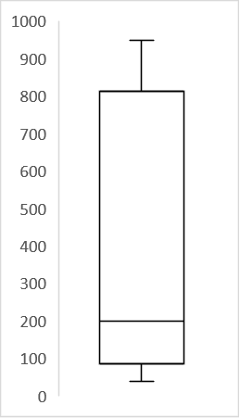
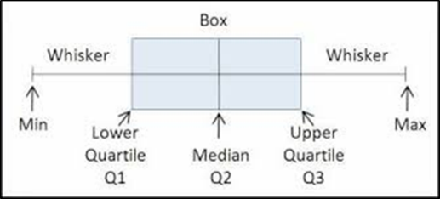
Boxplot
A visual representation of 5- number summary. A box over the 5-numbers- Min, Q1, Q2, Q3, Max,
Boxplot is used to study variation in the data, and to spot whether distribution of data is symmetric.
Boxplot = ‘Box and Whisker’ in MS Excel 2019.
Max
Q3
Q2
Q1
Min
Wherever there are outliers, the whisker line ends at Q3+1.5IQR (if outliers are on the higher side) or at Q1-1.5IQR (if outliers are on the lower side)

Slide 43
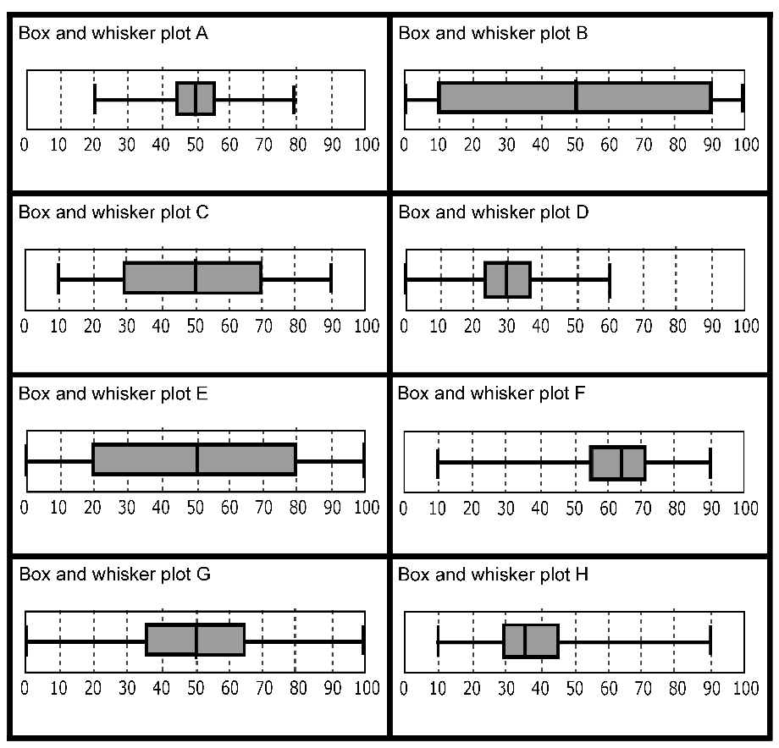
Typical Boxplots
1 5
2 6
3 7
4 8

Slide 44

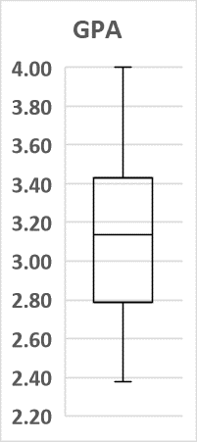
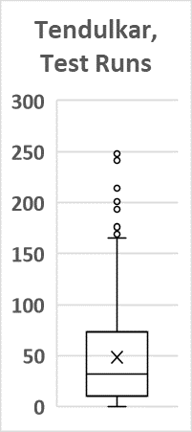
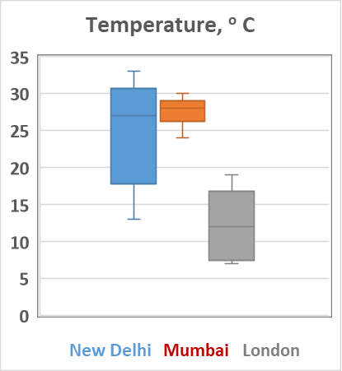
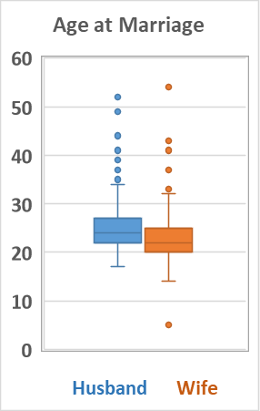
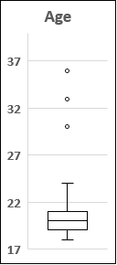
Take 5… Boxplots stories

Slide 45
Covariance and Correlation
(will be done later in Chapter#12, Simple Linear Regression)

Slide 46
MS Excel functions….1/2
Excel function Example Result
=Average(Range) =Average(1,2,3,4) 2.5
=Median(Range) =Median(6,4,5,3,2) 4
=Mode(Range) =Mode(2,3,3,4,5,5,5,5) 5
=Var.p(Range) =Var.p(1,2,3,4,10) 10.000
=Stdev,p(Range) =Stdev.p(1,2,3,4,10) 3.162

Slide 47
MS Excel functions….2/2
Excel function Example Result
=Min(Range) Min(2,3,4,7,8) 2
=Max(Range) Max(2,3,4,7,8) 9
=Quartile.Inc(Array,#Q)
(Q= 1,2,3)

Slide 48
Numerical Description Measures
Mean, Median, Mode
Min, Max, Range
Variance, Stddev, CoV
5 – Number summary
Min, Q1, Q2, Q3, Max
Inter Quartile Range: Q3-Q1
Skewness
Kurtosis
You can use MS Excel to calculate these descriptive measures

Slide 49
Q&A - Discussion on exam pattern

